Slide 1
Sentiment Analysis in R
Jenn Schilling
October 20, 2021
Notes:
Welcome to Day 1 of the Sentiment Analysis in R webinar. I am so happy you’re here.

Slide 2

Hello!
Jenn Schilling
she/her/hers
Senior Data Analyst, University Analytics & Institutional Research, University of Arizona
Adjunct Faculty, College for Creative Studies
Notes:
I’m Jenn Schilling, my pronouns are she/her/hers. I am a senior data analyst at the University of Arizona, and an adjunct faculty member at the College for Creative Studies where I teach graduate classes on data visualization. Thank you for being here, and I hope you will find this webinar beneficial. Before I begin, I would like acknowledge that I am on the ancestral lands of the Tohono O'odham and Pascua Yaqui nations, indigenous peoples who have occupied this land since time immemorial.
Territory acknowledgements are one small part of disrupting and dismantling colonial structures.

Slide 3
Learning Outcomes
Prepare data for a text analysis in R
Conduct text mining in R
Complete sentiment analysis in R
Notes:
The learning outcomes of this webinar are that participants will be able to prepare data for a text analysis, conduct text mining, and complete a sentiment analysis in R.

Slide 4
Day 1 Agenda
Introduction to Text & Sentiment Analysis
R Set-Up
Data Processing
Tokenizing
Word Frequencies
Questions
Notes:
This webinar will teach participants how to complete a text analysis in R, including data processing and cleaning, visualization of word frequencies, and sentiment analysis. Sentiment analysis is useful for finding patterns in text data from open response questions on surveys and course evaluations as well as evaluating social media posts.
Today we will go over…

Slide 5
What is text analysis?
Notes:
Text analysis is the processing and analyzing of text data. We frequently encounter text data in higher education through course descriptions, student feedback on surveys or course evaluations, and social media posts. Text analysis allows us to analyze that data to determine word frequencies, common themes, and patterns.
One challenge with text analysis is that words can have multiple meanings depending on context and interpretation. Text analysis and sentiment analysis do not pick up on sarcasm, tone, or context. However, they can be useful to find broad commonalities and overarching themes.

Slide 6
What is sentiment analysis?
Notes:
A component of text analysis is sentiment analysis which aims to determine the sentiment of a piece of text – is it positive or negative? Does it invoke joy or sadness? There are a few different dictionaries of word sentiments that can be used to determine the feeling behind a piece of text. Again, the sentiment can sometimes be off due to context, sarcasm, etc. but it can be a useful analysis for approximating the broad feelings behind text.

Slide 7
Why is it useful?
Notes:
Text and sentiment analysis are useful for analyzing large quantities of text automatically. They can help us find general themes and feelings, and they allow us to quite quickly analyze text data that could take a long time to process by hand. Applications to institutional research include analyzing course evaluations, student, faculty, or staff responses to surveys, and social media content. In the example we will walk through in this webinar, I will be analyzing tweets that use the University of Arizona hashtag.

Slide 8
Terminology
Corpus
Document
Token / Term / Word
Notes:
Before we jump into R, I first want to go over a couple of pieces of terminology that we will be using.
A corpus is a large collection or set of documents.
A document is an individual piece of text data such as a book, an email, a tweet or set of tweets, responses to an open-ended survey question, a course evaluation, etc.
A token is a meaningful unit of text, such as a word. Tokens may also be referred to as terms.
A document is made up of words/terms/tokens. A corpus is made up of documents.

Slide 9
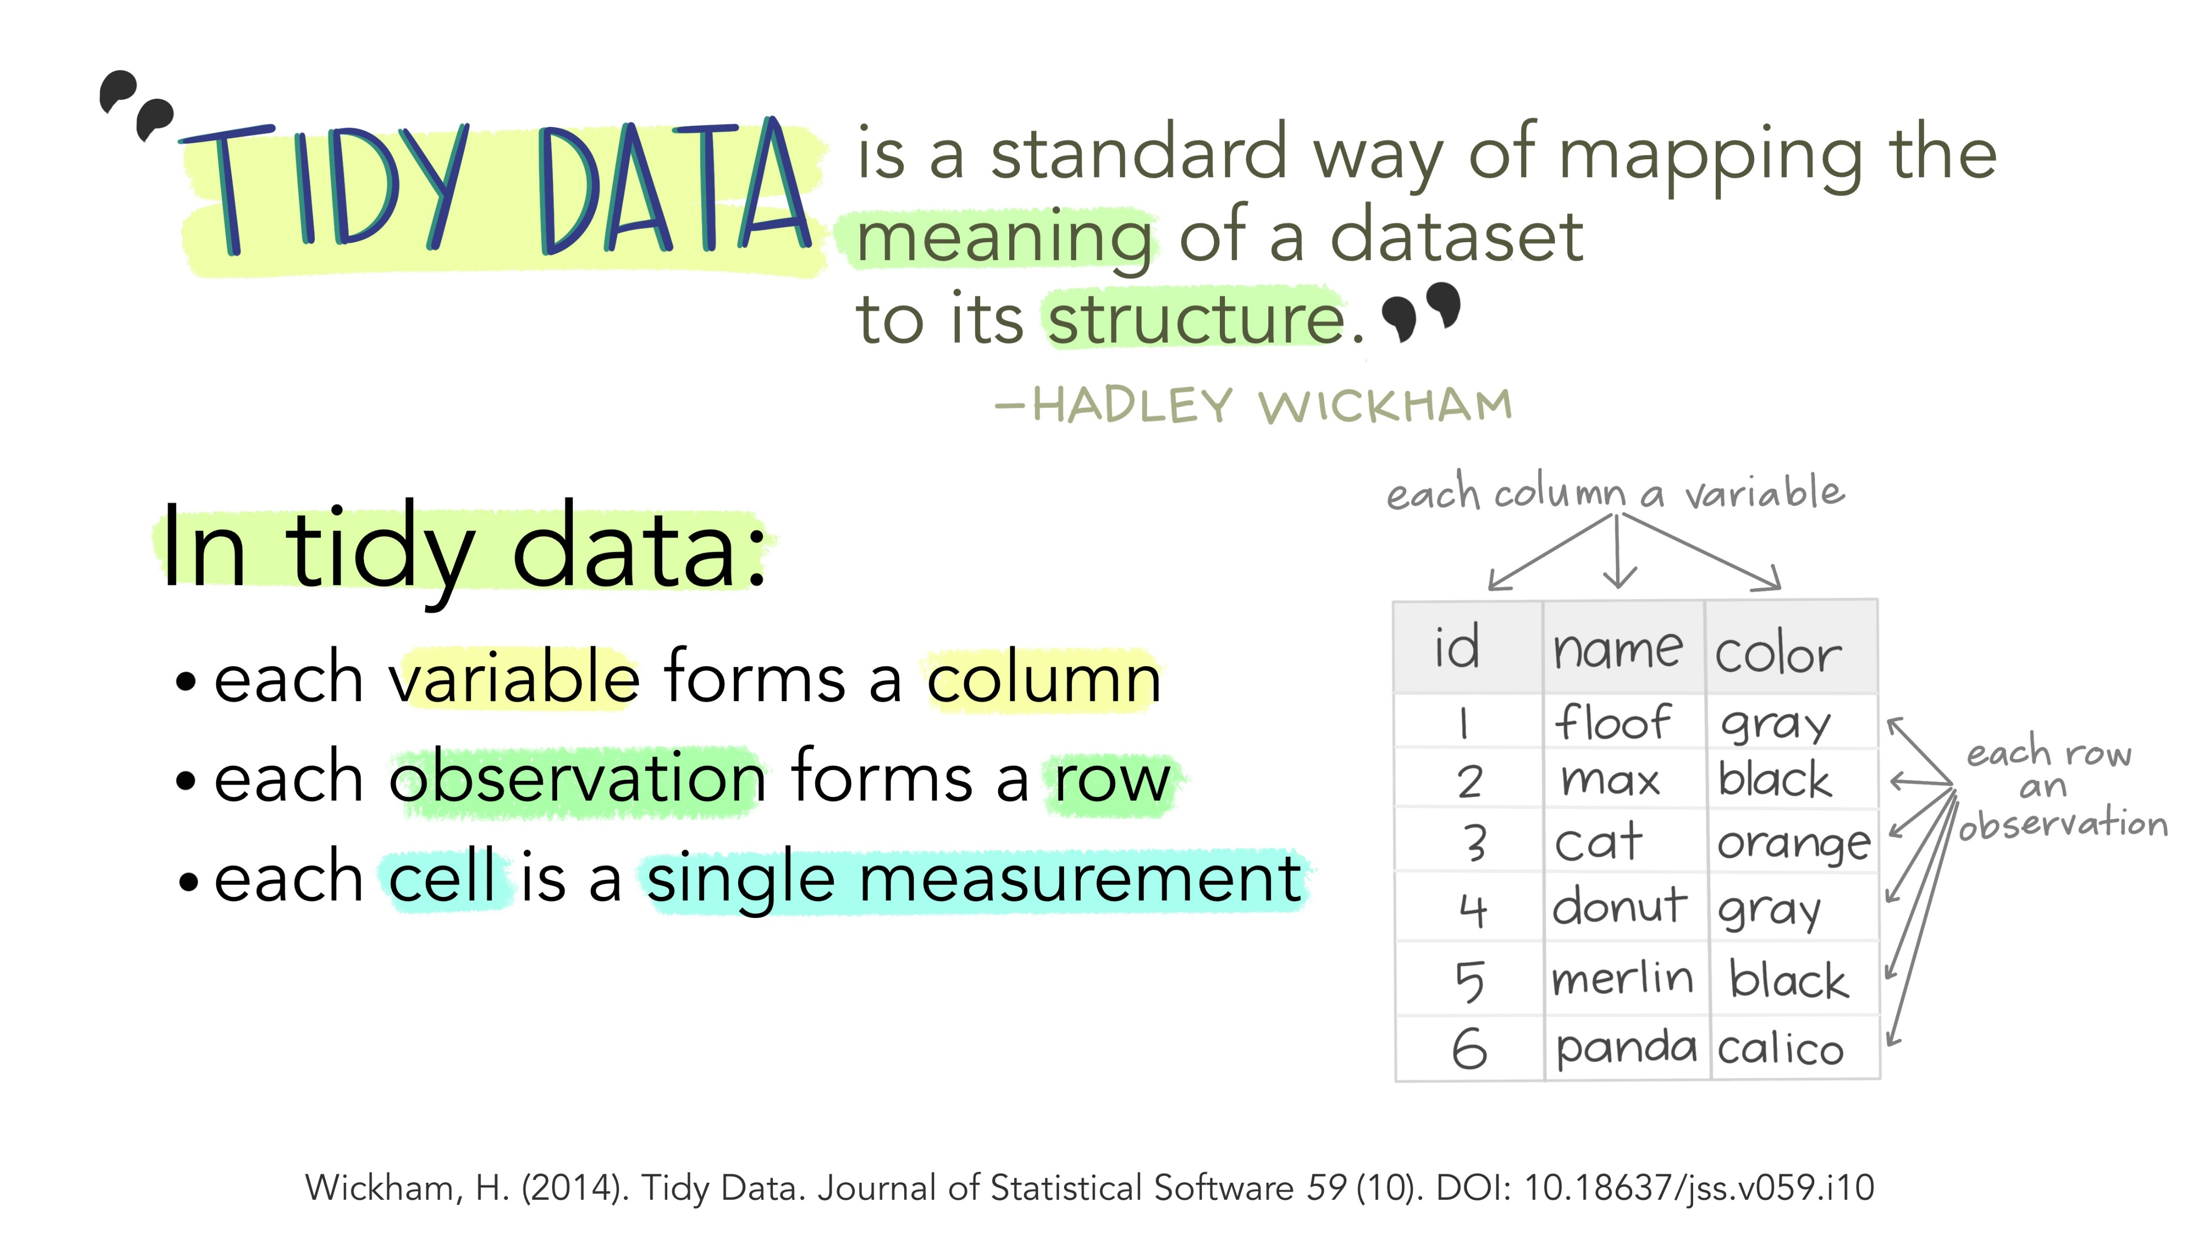
Illustrations from the Openscapes blog Tidy Data for reproducibility, efficiency, and collaboration by Julia Lowndes and Allison Horst
Notes:
Next, I would like to define tidy data. Tidy data is a structure of data in which each variable is a column, each observation is a row, and each cell is a single measurement. For text analysis, we can create a tidy text data table or data frame which contains one token per row. Recall that a token is a meaningful unit of text, such as a word. The first step in text analysis is called tokenizing, which involves splitting a long text string, such as a tweet, document, or open-ended responses, into individual words or sets of words.

Slide 10
R Setup
General Setup
R Markdown
tidyverse package
tidytext package
Text data
Webinar Materials
code
sentiment-analysis-in-r.Rmd
data
uarizona_tweets.csv
.here
README.txt
Notes:
To get set up in R, all you will need is the tidyverse and tidytext packages installed and a set of text data. We will also use the wordcloud package in this webinar, but it not necessarily required for a text analysis.
R Markdown is a very useful tool/file format that can be used to create documentation along with your code. This is ideal for reproducibility.
The webinar materials provided include an R Markdown file with all the code to process the data and complete the text analysis and the data file used. The .here file is needed so that the R Markdown code knows where to find the data file. The README file contains more information about each individual file and the structure of the folder.

Slide 11
R

Slide 12
What did we learn today?
Introduction to Text & Sentiment Analysis
R Set-Up
Data Processing
Tokenizing
Word Frequencies
Notes:
We talked about text analysis and sentiment analysis and how they can be used. Then we discussed how to set up R for text analysis. In R, we jumped into processing and preparing the data for text analysis. Next, we covered tokenizing and computing word frequencies.
One thing we did not talk about today is stemming. Stemming can be a useful technique in text analysis and is usually completed as part of the tokenizing process. Stemming is reducing words down to their root. So, a set of words like consult, consultant, consulting, consulted, consultants, would all be reduced to the stem word consult. It can be a useful way to bring down the word list and identify key themes in a set of documents. If a set of documents uses a common root but different words (as in the example just mentioned with consult), then stemming can be very useful. Stemming can also be completed in R, and would most likely be done after the tokenizing process, before computing any word frequencies.

Slide 13
Questions
Notes:
Thank you so much for being here today! I look forward to seeing you in Part 2. Thank you to AIR and Emily and Elaine for their support and for having me.

Slide 14
Sentiment Analysis in R
Jenn Schilling
October 22, 2021
Notes:
Welcome back to Day 2 of the Sentiment Analysis in R webinar. I am so happy you’re here.

Slide 15
Hello!
Jenn Schilling
she/her/hers
Senior Data Analyst, University Analytics & Institutional Research, University of Arizona
Adjunct Faculty, College for Creative Studies
Notes:
I’m Jenn Schilling, my pronouns are she/her/hers. I am a senior data analyst at the University of Arizona, and an adjunct faculty member at the College for Creative Studies where I teach graduate classes on data visualization. Thank you for being here, and I hope you will find this webinar beneficial.

Slide 16
Learning Outcomes
Prepare data for a text analysis in R
Conduct text mining in R
Complete sentiment analysis in R
Notes:
The learning outcomes of this webinar are that participants will be able to prepare data for a text analysis, conduct text mining, and complete a sentiment analysis in R.

Slide 17
Day 2 Agenda
Recap of previous session
Sentiment Analysis
Visualizing Results
Moving Beyond Words
Where to go from here
Questions
Notes:
This webinar will teach participants how to complete a text analysis in R, including data processing and cleaning, visualization of word frequencies, and sentiment analysis. Sentiment analysis is useful for finding patterns in text data from open response questions on surveys and course evaluations as well as evaluating social media posts.
Here’s today’s agenda…

Slide 18
Quick Recap
Introduction to Text & Sentiment Analysis
R Set-Up
Data Processing
Tokenizing
Word Frequencies
Notes:
In Day 1, we talked about text analysis and sentiment analysis and how they can be used. Then we discussed how to set up R for text analysis. In R, we jumped into processing and preparing the data for text analysis. Next, we covered tokenizing and computing word frequencies.
As a reminder, in R you need the {tidyverse} and {tidytext} packages for data processing and text analysis.

Slide 19
Terminology
Corpus
Document
Token / Term / Word
Notes:
Here’s a quick review of some of the terminology used in text analysis.
A corpus is a large collection or set of documents.
A document is an individual piece of text data such as a book, an email, a tweet or set of tweets, responses to an open-ended survey question, a course evaluation, etc.
A token is a meaningful unit of text, such as a word. Tokens may also be referred to as terms.
A document is made up of words/terms/tokens. A corpus is made up of documents.

Slide 20
Illustrations from the Openscapes blog Tidy Data for reproducibility, efficiency, and collaboration by Julia Lowndes and Allison Horst
Notes:
Here’s a reminder of tidy data. Tidy data is a structure of data in which each variable is a column, each observation is a row, and each cell is a single measurement. For text analysis, we can create a tidy text data table or data frame which contains one token per row. Recall that a token is a meaningful unit of text, such as a word. The first step in text analysis is called tokenizing, which involves splitting a long text string, such as a tweet, document, or open-ended responses, into individual words or sets of words.

Slide 21
R

Slide 22
What insights can be gained from text and sentiment analysis?
Notes:
Text and sentiment analysis are useful for analyzing large quantities of text automatically. They can help us find general themes and feelings, and they allow us to quite quickly analyze text data that could take a long time to process by hand. Applications to institutional research include analyzing course evaluations, student, faculty, or staff responses to surveys, and social media content. In the example we used in this webinar, I analyzed tweets that use the University of Arizona hashtag.
And we found sentiment and word frequencies by day as well as overall the tweets. We could see when the University of Arizona football team was not performing well, and when other topics such as Hispanic Heritage Month or Cancer Awareness were being discussed.

Slide 23
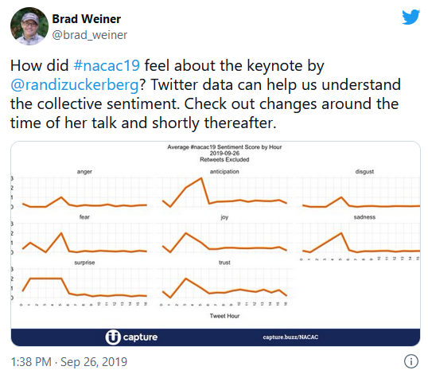
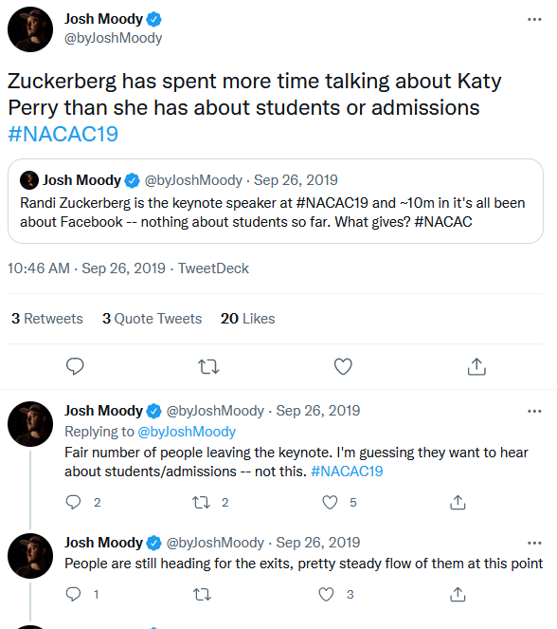
Example
Notes:
In 2019, the National Association for College Admission Counseling’s national conference had an opening keynote by Randi Zuckerberg that was widely criticized. A colleague of mine, Brad Weiner, currently the interim Chief Data Officer at the University of Colorado Boulder used to do fairly real time analytics on Twitter from the NACAC conference. He shared his example with me from an analysis he did of the sentiments of tweets using the #nacac19, you can see a pretty significant increase in the anger, disgust, fear, and sadness sentiments while there’s a decline in anticipation, joy, and trust around the time of the opening keynote. This is just one more example of how sentiment analysis can be interesting and useful.

Slide 24
Where to go next
Try out a text analysis of your own.
Review Text Mining with R by Julia Silge and David Robinson
https://www.tidytextmining.com/index.html
Notes:
Using the provided code, switch out the example tweet data for text data of your own. Then try out the code and see what insights you can find in your own text analysis.
The book Text Mining with R by Julia Silge and David Robinson is available online at the URL provided above. This is an extensive resource for text analysis in R and contains lots of examples. If you want to go further with the analysis of Twitter data, it includes a whole case study comparing tweets from each of the authors. There is also a chapter on analyzing n-grams, which expands text analysis from 1 word to multiple words. The book also contains information on how to do some modeling with text data. It is a very comprehensive resource if you’d like to learn more about text analysis in R.

Slide 25
What did we learn today?
Sentiment Analysis
Visualizing Results
Moving Beyond Words
Where to go from here
Notes:
After recapping the previous session, we dove into a complete sentiment analysis and visualized the findings. We also discussed how to move beyond individual words in a text analysis and went through a short example of two-word phrases. Finally, we reviewed the insights that can be gained from text and sentiment analysis and discussed how to go further.

Slide 26
Questions
Notes:
Thank you so much for being here today. I hope this webinar was beneficial. Thank you to AIR for having me and to Elaine and Emily for their support.

Slide 27
References
Silge, J., & Robinson, D. (2017). Text mining with R: A tidy approach. O'Reilly Media.
Silge, J., &amp; Robinson, D. (2021, April 10). Introduction to tidytext. Retrieved September 28, 2021, from https://cran.r-project.org/web/packages/tidytext/vignettes/tidytext.html.
Notes:
Thank you again for joining this webinar. I hope you found it beneficial and helpful. I am so glad I got to spend a couple of hours with you this week.

